Slide 1

Sovereign Bank
Pedro Leite
ServiceWow
Notes:
Hello, my name is Pedro Leite, it’s a pleasure to be here, bringing solutions

Slide 2





Meet our team
Eric Jehl
Marta Hernandez
Solution Architect
ITSM, Discovery, HRSD, Business Analysis
Solution Architect
ITSM, SPM, Integration
Pedro Leite
Rajesh Kumar
Solution Architect
CSM, FSM, Integration, Discovery, Automation
Solution Architect
IRM, SecOps, ITSM, Integration
Suzi Matsui
Vaibhav Maheshwari
Solution Architect
ITSM, Integration, Automation, CSM, HRSD
Solution Architect
ITSM, SAM, ITAM, Integration

Slide 3
Strengths
Experience
Multi-Language capabilities
>30 years
EN, HI, ES, PT
Certificates
Experts
>20
ITSM, IRM, SecOps, SPM, Integrations, CSM, FSM, ITSM, HR, SAM
Clients background
Public System, Bank, Services, Food industry, HealthCare, Pharma, Retail
Presentation Title

Slide 4






Anticipated Challenges
Regulatory Compliance
Data Security
and Privacy
Integration
Data Migration
and Integrity
Organizational Change Management
Complexity
and Scale
Notes:
Regulatory Compliance
Data Security and Privacy
Integration

Slide 5

Regulatory Compliance
Compliance with all relevant regulations (e.g. GDPR, PCI, CSS)
Using risk assessment tools to manage compliance risks.
Implement Access Controls
Notes:
(Introductory topic text)
Regulatory compliance is crucial for banks as it ensures they operate within legal frameworks, avoid financial penalties, maintain customer trust, and protect the integrity of the financial system.To maintain regulatory compliance, Sovereign Bank must implement fine-grained access controls to restrict data visibility by region, map regulatory requirements to ServiceNow features such as field encryption, and ensure continuous monitoring and governance to adapt to evolving regulations.
(Bullet points on the slide)
That can be achieved, using ServiceNow since it offers the possibility of Compliance with all relevant regulations (e.g. GDPR, PCI, CSS). It also provides using risk assessment tools to manage compliance risks and it allows to implement access controls.

Slide 6

Data Security and Privacy
Role-Based Access Controls limit sensitive data access to authorized personnel.
Field Level Encryption for storing Sensitive Data
Multi-Factor Authentication and Single Sign-on
Notes:
(Introductory topic text)
To safeguard Personally Identifiable Information such as SSNs, financial transactions, and HR data, Sovereign Bank must navigate cross-border data sharing restrictions imposed by GDPR and PDPA while mitigating cybersecurity risks across its on-premise, hybrid, and cloud environments.
(Bullet points on the slide)
ServiceNow strengthens security by enforcing Role-Based Access Controls, ensuring only authorized personnel access sensitive information. Field-Level Encryption protects critical data while maintaining usability, and Multi-Factor Authentication with Single Sign-On enhances secure access across systems. These capabilities help Sovereign Bank mitigate risks and maintain compliance.

Slide 7

Integration
Enforce Oauth 2.0 and mutual authentication.
Support from APIs and web services
(REST and SOAP).
MID Servers for secure integrations.
Notes:
(Introductory topic text)
Sovereign Bank must integrate legacy and cloud systems while navigating firewall restrictions, security constraints, and authentication challenges.
(Bullet points on the slide)
ServiceNow simplifies integration by enforcing OAuth 2.0 and mutual authentication for secure communication, supporting REST and SOAP APIs for seamless data exchange, and utilizing MID Servers to enable secure on-premise connectivity. These solutions ensure interoperability while maintaining compliance and security.

Slide 8
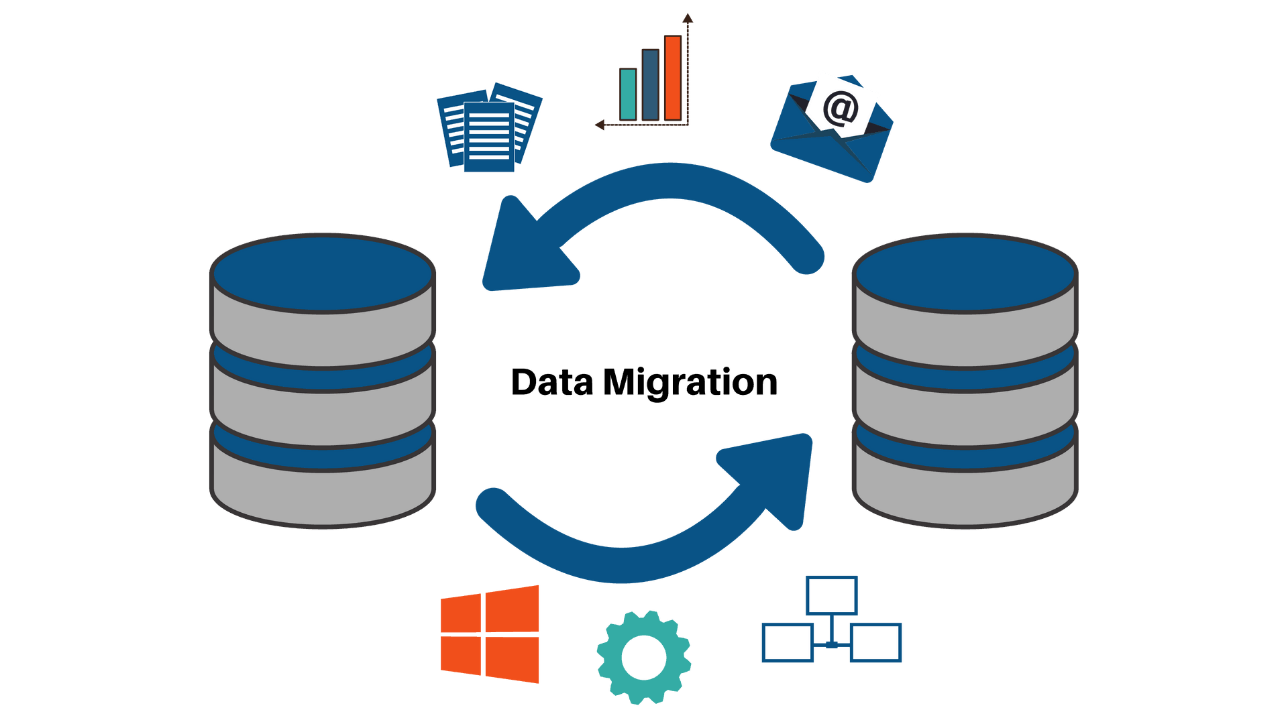
Data Migration and Integrity
Use of Integration Hub to import data from Remedy
For CMDB, sanitize the data using Identification and Reconciliation Engine
Only import relevant data
ServiceNow provides tools like Data Certification for data quality assessment and cleansing.
Notes:
(Introductory topic text)
To ensure successful data migration and integrity, Sovereign Bank must consolidate and cleanse data from multiple legacy systems, prevent data loss or corruption during the transition, and establish robust validation mechanisms to maintain accuracy and consistency across the new ServiceNow platform.
(Bullet points on the slide)
To successfully achieve this with ServiceNow, while preventing data loss, the Bank can use Integration Hub to import data from Remedy, for CMDB, it can sanitize the data using Identification and Reconciliation Engine. To maintain data quality, ServiceNow provides tools like Data Certification for data quality assessment and cleansing.

Slide 9

Organizational Change Management
Collaboration tools and stakeholder engagement promote transparency.
Automated workflows free up employees for higher-value work.
Knowledge Articles/Base creation, surveys
Guided Tours and self-service training ease the transition.
Notes:
(Introductory topic text)
To drive successful adoption of ServiceNow, Sovereign Bank must address resistance to process changes from long-tenured employees, align conflicting priorities across business units, and mitigate fears of job losses due to automation through clear communication and change management strategies.
(Bullet points on the slide)
Sovereign Bank faces resistance to change, conflicting priorities, and job security concerns. ServiceNow promotes transparency through collaboration tools and stakeholder engagement, ensuring alignment across teams. Automated workflows reduce manual tasks, allowing employees to focus on higher-value work. Guided Tours and self-service training ease adoption, while Knowledge Articles and surveys empower users and gather feedback. By leveraging these features, Sovereign Bank can drive a smooth and efficient transition.

Slide 10
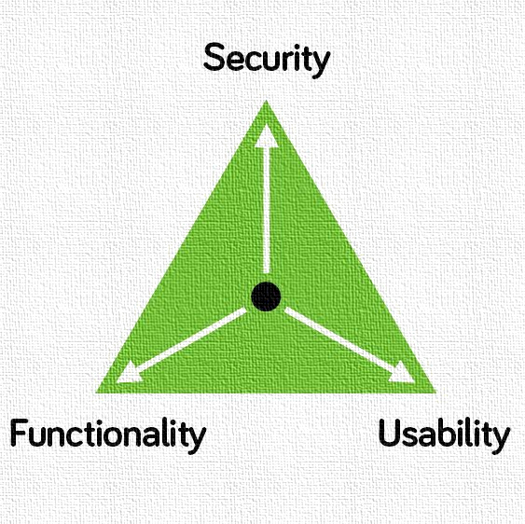
Complexity and Scale
Modular implementation allows phased implementation approach
Performance optimization tools
Scalable Architecture that supports large organizations
Notes:
(Introductory topic text)
Sovereign Bank’s large workforce, global operations, and diverse IT policies make ITSM standardization and performance scalability challenging.
(Bullet points on the slide)
ServiceNow addresses these challenges with a modular implementation approach for phased rollouts, performance optimization tools to handle high data volumes, and a scalable architecture that supports large enterprises, ensuring long-term efficiency and growth.

Slide 11




Thank you
Pedro Leite
pedro.leite@sw-consultancy.com
www.servicewow-consultancy.com

